Slide 1
Welcome to CS170 Introduction to Unix
Instructor: Li Feng
Capital University

Slide 2
Course Information
Instructor: Li Feng
117A Battelle Hall
lfeng@capital.edu
Office hour:
Monday 8:30am – 9:00am, 1:30pm-2:30pm
Tuesday 8:30am – 9:30am
Wednesday 8:30am – 9:00am, 1:30pm-2:00pm
Thursday 8:30am – 9:30am
Friday 8:30am – 9:00am
Or by appointment

Slide 3
Introduce yourself: name, what year are you in, your hobby, anything you want to share…

Slide 4
Contents covered in this course:
A subset of Unix commands
Common Unix editors
Shell scripting
Git

Slide 5
Course Grading
35%: in-lecture quizzes
40%: Lab and Assignments
20%: final exam (comprehensive)
5%: attendance and participation

Slide 6
Academic Integrity:
If you wouldn't want fellow students, parents, or professors to know about it, it's probably cheating
If it feels like cheating, it probably is

Slide 7
The Myth of Multitasking
https://youtu.be/PriSFBu5CLs @ 7:50-10:00 (Clifford Nass, Stanford)
Allowing yourself to respond to distraction (incoming email, IM, etc.) triggers small dopamine release
Over time, you get addicted to it
Result: Multitaskers waste far more brainpower than monotaskers when actually distracted
Long-term effects can be hard to reverse

Slide 8
Introduction: What is Unix?
An operating system
Developed at AT&T Bell Labs in the 1960’s
Command Line Interface (CLI)
GUIs (Window systems) are now available
Notes:
Operating system: middle level between hardware and software. It schedules tasks, allocates storage and handles the interfaces to peripheral hardware (printers, disk drives…)

Slide 9
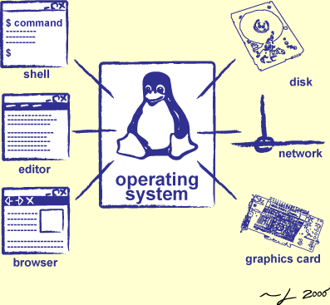
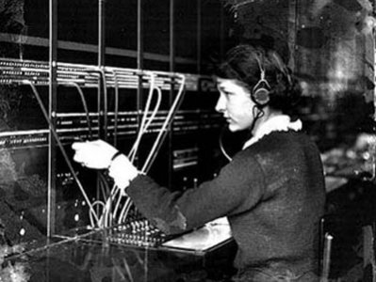
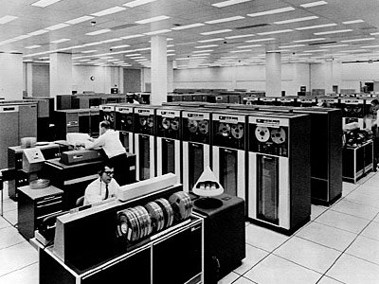
Operator …
Switchboard Operator
Computer Operators

Slide 10
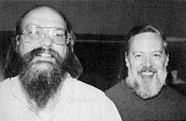
The 1983 Turing Award: Ken Thompson and Dennis Ritchie
UNIX: Making Computers Easier To Use -- AT&T Archives film from 1982, Bell Laboratories
Notes:
Multics: OS on main frame
Cool stuff: Daemons (log in, pixel in screen) and dynamic linking
C language: 1971
For their development of generic operating systems theory and specifically for the implementation of the UNIX operating system
ACM: Association for Computer Machinery. Highest distinction in computer science. Nobel prize in computing.

Slide 11
Introduction: Features
Multiuser
Both command line interface and window environment
Designed by programmer for programmer
Very customizable
Combine small program easily to do complex tasks
You don’t need to worry about “crashing the system” by formatting the disk or deleting system files. (superuser)
Notes:
Multiuser systems divide computer resources among multiple users, allowing for more efficient use of these resources

Slide 12
Introduction: Types of Unix
Many different versions of Unix:
Sun Solaris
GNU/Linux
Mac OS X
All the Unix versions are mostly the same:
Same command works (slightly different syntax)
Complied program on one can usually be compiled without any changes or minor changes in the other
The location of system files varies but the differences are usually transparent to the end-users

Slide 13
Introduction: Unix vs. Linux
Unix was the predecessor of Linux
Linux is developed by a grad student (Linus Torvalds) in Finland in 1991
Linux is a variant of Unix
Linux is open source
Linux distributions: Ubuntu, Fedora, Red Hat, Debian, Arch, CentOS…
Android is also a Linux based OS for mobile device.
Linus Torvalds
Source: wikipedia
Notes:
Torvalds also developed version control tool: git

Slide 14
Introduction: Why Unix/Linux?
Linux is free
It’s portable
It’s fully customizable
It’s stable (i.e. it almost never crashes)
A rich selection of applications is available for Linux
A mount of software is also available.
These characteristics make it an ideal OS for programmers and scientists

Slide 15
Introduction: Linux is made up of 3 parts
The kernel: the hub of the OS
The shell: the command line interpreter (CLI), the interface between the user and the kernel
The program

Slide 16
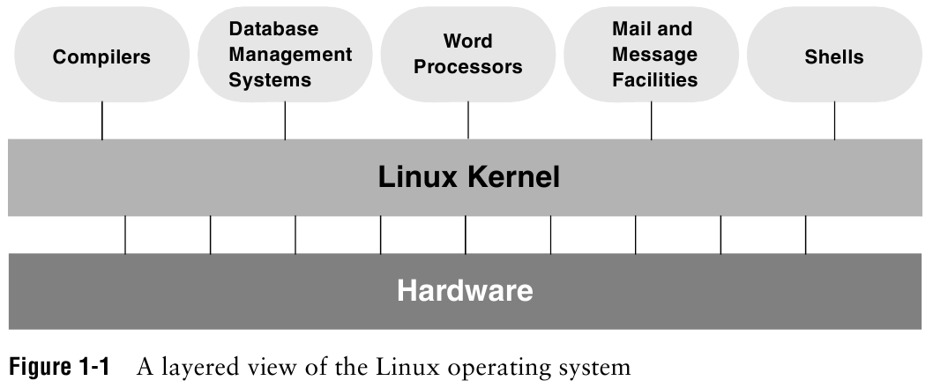
Introduction: Linux
Notes:
Kernel: most frequently used functions: scheduling user jobs, allocating computer resources, interface with program

Slide 17
Introduction: Overview of Linux
Kernel programming interface
Multiuser
Multitask OS
Secure hierarchical filesystem
Shell
A family of utility program (commands)
Interprocess communication (several utility together)
System administration
Notes:
Everything in UNIX is either a file or a process
Shell: command interpreter, interface between you and kernel (the OS)
Interprocess communication: pipeline and filter

Slide 18
Connecting to a Unix/Linux system
Windows user:
Download and Install Virtual Box
Download and Install Ubuntu
Open a terminal

Slide 19
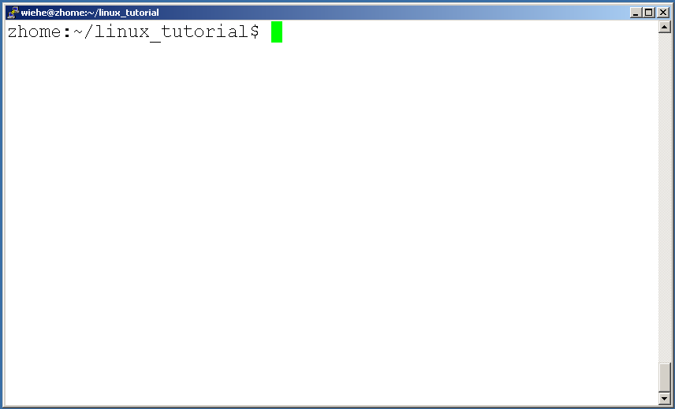
Connecting to a Unix/Linux system
Mac user:
Open up a terminal:
Notes:
Applications/accessories menu: Terminal icon

Slide 20
Connecting to a Unix/Linux system
Open up a terminal:
The “prompt”
The current directory (“path”)
The host
Notes:
Prompt could be a dollar sign($), or a hashmark(#) or a present sign(%)

Slide 21
What exactly is a “shell”?
After logging in, Linux/Unix starts the shell
The shell interprets commands the user types and manages their execution
The shell is the interface between you and the kernel
The most popular shells are: tcsh, csh, korn, and bash (which shell are you running?)
The adept user can customize his/her own shell, and users can use different shells on the same machine
The differences are most times subtle
Shell commands are CASE SENSITIVE!
Notes:
Enter “echo $0” and press ENTER

Slide 22
Help!
Whenever you need help with a command type “man” and the command name

Slide 23
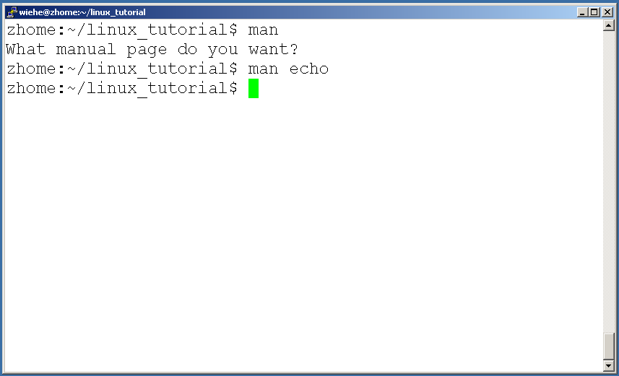
Help!

Slide 24
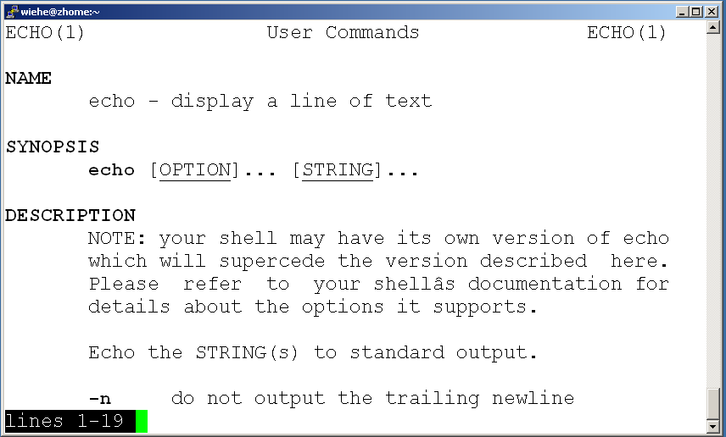
Help!

Slide 25
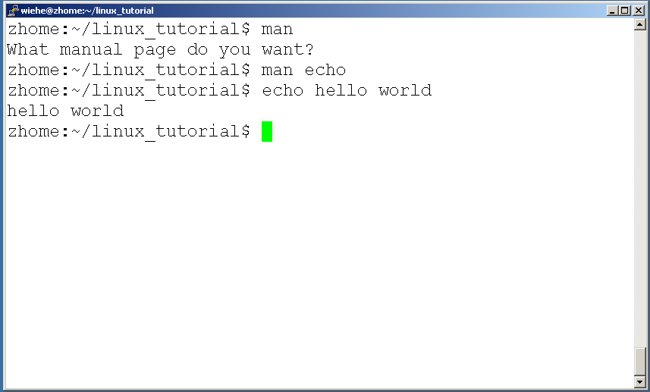
Help!
Notes:
Echo: display text

Slide 26
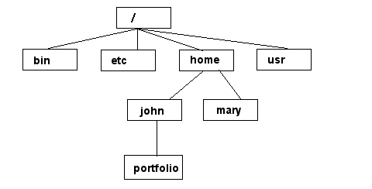
Unix/Linux File System
NOTE: Unix file names
are CASE SENSITIVE!
/home/mary/
/home/john/portfolio/
The Path
Notes:
/: root directory
~: your home directory
The Linux file system is a hierarchy in which the root directory appears at the top of the system and branches come off the root, with each branch supporting
one or more plain or directory files.

Slide 27
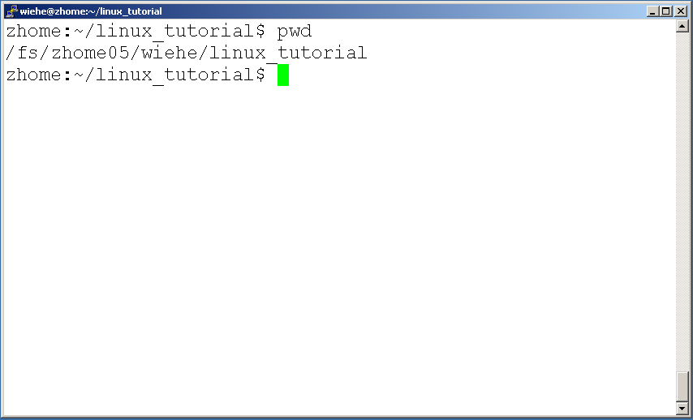
Command: pwd
To find your current path use “pwd”
Notes:
Pwd: print working directory
Pathnames enable you to work out where you are in relation to the whole file-system. Find out the absolute pathname of your home-directory

Slide 28
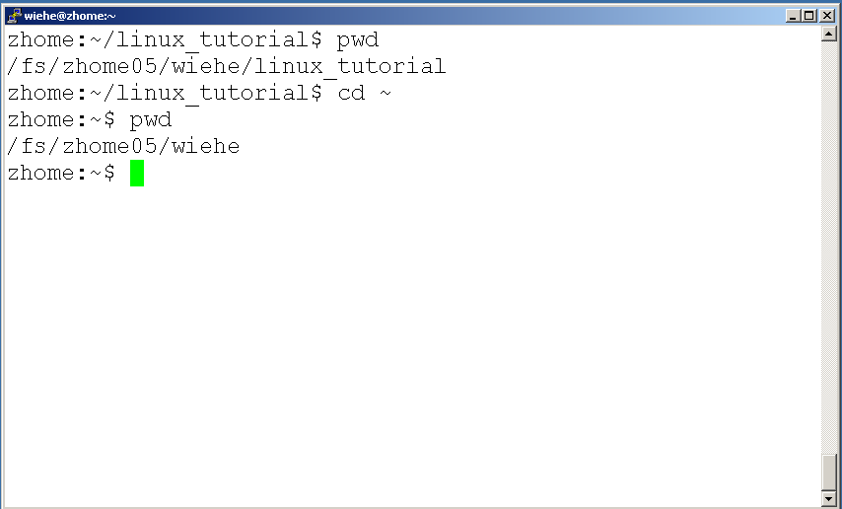
Command: cd
“~” is the location of your home directory
Notes:
Cd: change directory
Shortcut to your home directory: cd /home/li (absolute path), cd ~,
cd (space) Typing cd with no argument always returns you to your home directory. This is very useful if you are lost in the file system.

Slide 29
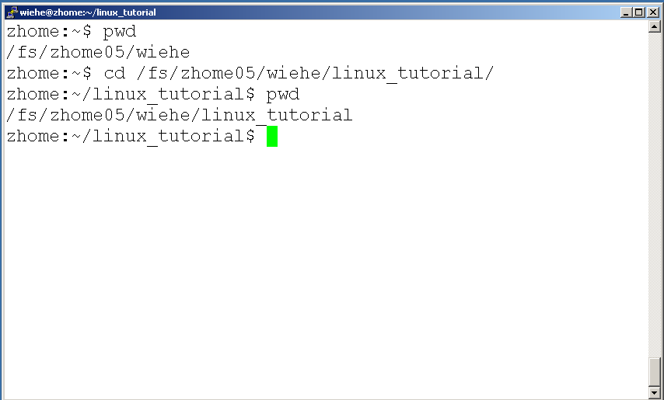
Command: cd
To change to a specific directory use “cd”

Slide 30
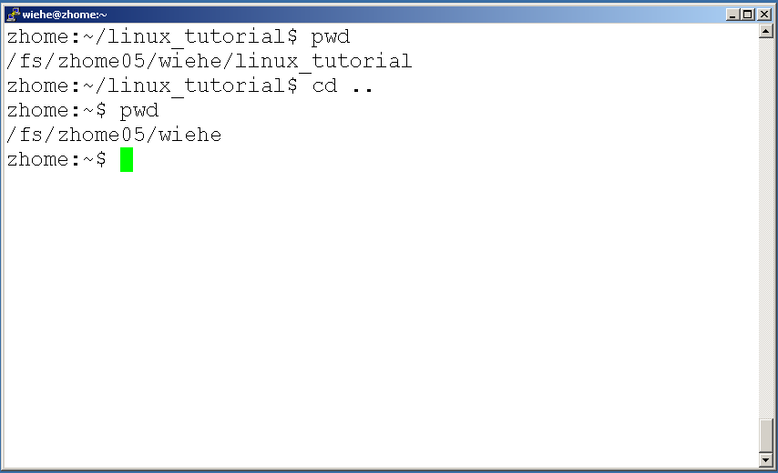
Command: cd
“..” means the parent of the current directory; it will take you one directory up the hierarchy.
Notes:
(.) means the current directory, so typing “cd .” (space between cd and the dot)
Cd - : previous directory

Slide 31
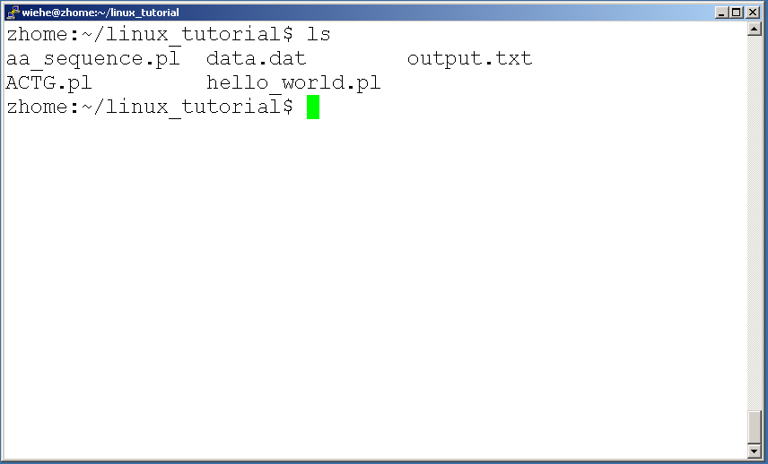
Command: ls
To list the files in the current directory use “ls”

Slide 32
Command: ls
ls has many options
-l long list (displays lots of info)
-t sort by modification time
-S sort by size
-h list file sizes in human readable format
-r reverse the order
-a list all files including those whose names begin with a dot type
“man ls” for more options
Options can be combined: “ls -ltr”
Notes:
Files beginning with a dot(.) are know as hidden files and usually contains important program configuration information.

Slide 33
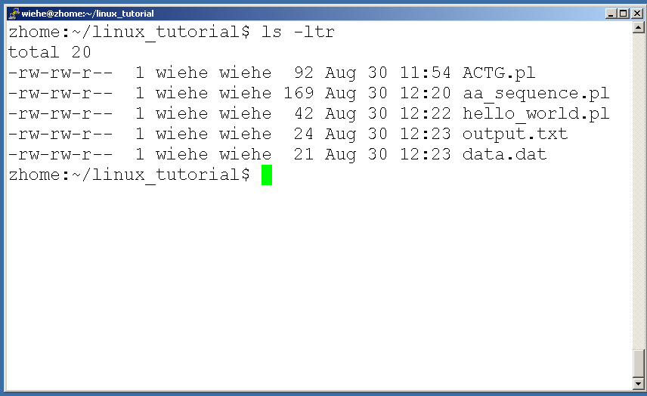
Command: ls -ltr
List files by time in reverse order with long listing

Slide 34
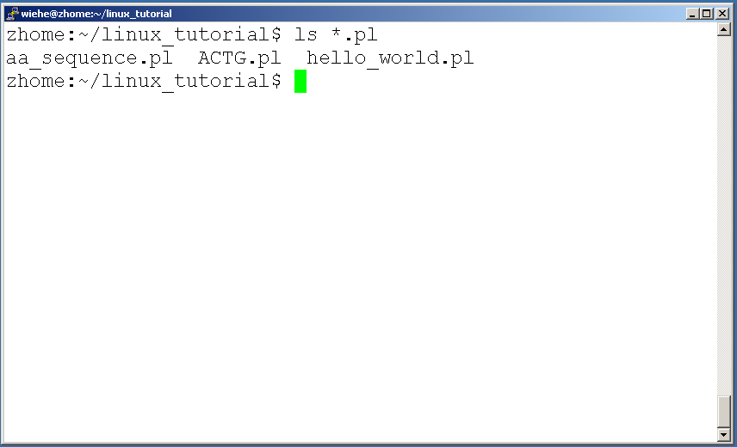
General Syntax: *
“*” can be used as a wildcard in unix/linux
Notes:
*: match against none or more characters in a file or directory name
?: match exactly one character.

Slide 35
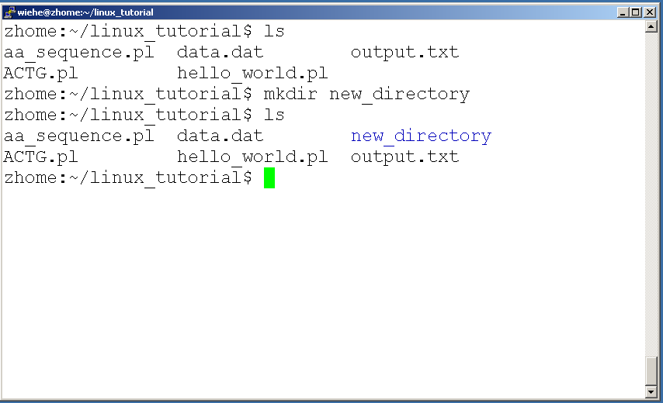
Command: mkdir
To create a new directory use “mkdir”
Notes:
mkdir: make directory

Slide 36
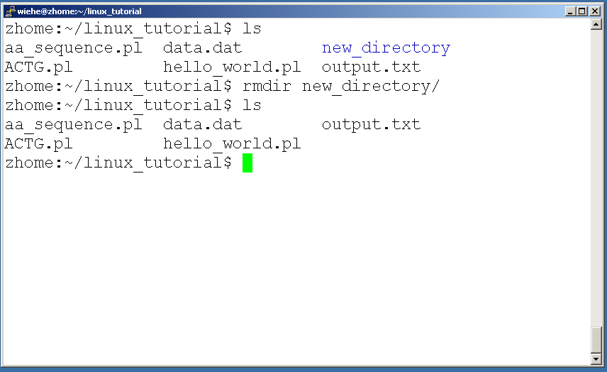
Command: rmdir
To remove and empty directory use “rmdir”

Slide 37
Tips:
Filename completion: By typing part of the name of a command, filename, pathname or variable and press TAB key, the shell will complete the rest of the name automatically (if it is unique).
History: The shell keeps a list of the commands you have typed in. If you need to repeat a command, use the cursor keys to scroll up and down the list or type history for a list of previous commands.
Notes:
Type completion:

Slide 38
Tips:
Delete a word: control-w. A word is any sequence of characters that does not contain a SPACE or TAB.
Delete a line: control-u.

Slide 39
Assignment 1: Handwritten Hardcopy is Due 23rd in class
Read chapter 1.
Page 18-19: Exercises 4, 5, 6, 7, 10
Read chapter2.
Page 46-47: Exercises 6, 7, 8, 9, 13
Try all the commands in chapter 1 and 2

Slide 40
Lab1 need use command "script”
Command ”script” is used to recording a shell session
Before you start all the commands in lab1:
script lab1.txt
…
…
exit: terminate the script session
You will obtain lab1.txt in the current directory, submit lab1.txt in iLearn by Jan 17, 11:59pm

